Slide 1
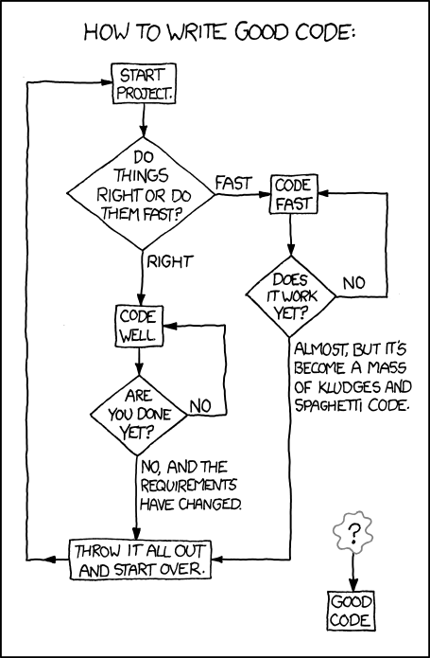
1.4:
Loops
ICS 3U/3C
David Beilby
Zeyad Nasr
Thomas Brittain

Slide 2
Loops
“A repeated if statement”
Functions that keep repeating until a specific condition is met.
while loops continue running as long as the specific condition is met
for loops are a type of while loop which iterate for a specific number of repeats.

Slide 3
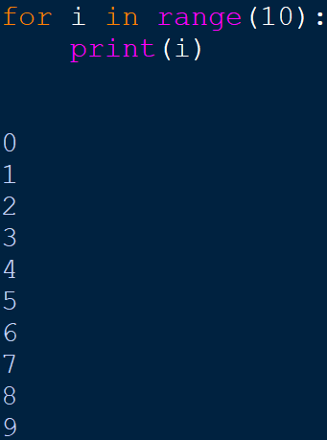
For Loops
Iterates a variable through an iterable
The range() iterable specifies a range of values to run through along with the incrementation.

Slide 4
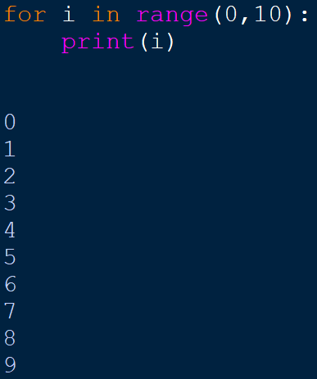
For Loops
Iterates a variable through an iterable
The range() function takes three arguments and returns an iterable object
The first 2 values represent the range of the iterable
The 3rd value represents the incrementation to iterate with.

Slide 5
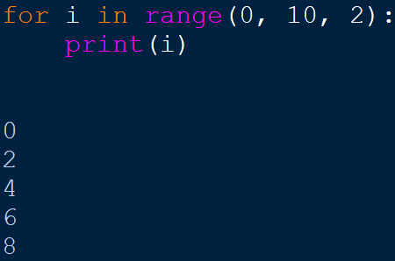
For Loops
Iterates a variable through an iterable
The range() function takes three arguments and returns an iterable object
The first 2 values represent the range of the iterable
The 3rd value represents the incrementation to iterate with.

Slide 6
Challenge!
Print the numbers from 1 to 20 omitting any numbers divisible by 3 or 5.

Slide 7
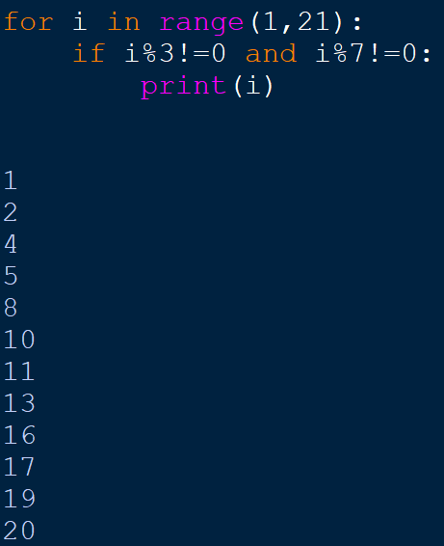
Challenge!

Slide 8
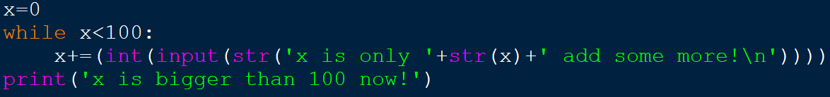
While Loops
Runs until a specified condition is met
Uses the same syntax as if statements:
Comparison and logical operators
and & or statements

Slide 9
Challenge!
Create a guessing game, which prompts the user whether their number input is below, above, or correct.

Slide 10
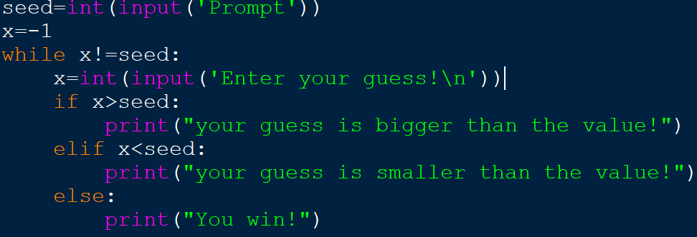
Challenge!

Slide 11
Some Helpful Code
break ends a loop or if statement
pass ends the current iteration of a statement.

